Slide 1
Blossom House School Careers Education
Blossom House School is committed to delivering a high standard of Careers Education, Information, Advice and Guidance.
We are fully compliant with the Baker Clause, and our aim is to ensure that our pupils are learning in an environment that suit their learning needs and abilities.
We aim to
support our students’ decision-making as they approach transitions and have to make choices
inspire them as they consider their future options
help them understand and develop their employability skills as they prepare for the world of work.

Slide 2
The Gatsby Benchmarks – what are they?
The Gatsby Benchmarks are a key measure of the effectiveness of career advice. They are also a very important part of the Government’s career strategy. In order to ensure our students enjoy high quality careers guidance and experiences, we will continue to embed the below eight Gatsby Benchmarks throughout our Careers Programme in line with DfE expectations.
A Stable Careers Programme
Learning from Career and Labour Market Information
Addressing the Needs of Each Pupil
Linking Curriculum Learning to Careers
Encounters with Employers and Employees
Experiences of Workplaces
Encounters With Further Education
Personal Guidance
For more information on the Gatsby benchmarks please click on the following link www.goodcareerguidance.org.uk

Slide 3
Employer Information
Enabling our pupils to engage with businesses, helps to prepare them for the world of work. We endeavour to provide opportunities via:
Career Fairs
Assemblies
Work experience / Volunteering
Mock interviews
Workplace visits
Interactive Workshops
We are currently seeking an organisation to partner with for our developing supported internship programme.
If you would like to know how you could support our school in terms of careers, please contact the Careers Lead Rita.Gavajena@blossomhouseschool.co.uk

Slide 4
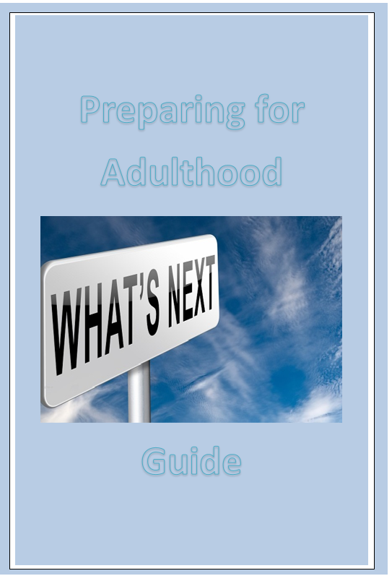
Parent Information
Preparing for Adulthood
Preparation should start early, to enable your son/daughter to make informed decisions about their future
Transition Year 9 Review Meeting
The Transition Review Meeting in Year 9 marks the start of planning for the young person’s transition to adulthood. This means thinking about what they will want to do when they leave school at age 16+, including:
Their next steps in education, as all young people must remain in education, employment or training until age 18.
Training and employment opportunities.
Becoming more independent, including where they will want to live.
Being part of their community (friendships, sport and leisure).
Qualifications and skills they will need to achieve their goals.
Health pathway, including a review of factors relating to their health.
Review meetings will continue to be held as the young person moves through their school and college years. EHC plan reviews must be person-centred, which means the young person's aspirations for the future will be key considerations for every decision made
There are various options available depending on ability, independence and support needs, these include:
Further Education at a college or training provider to undertake a course of study
Apprenticeships & Traineeships – gives students the opportunity to train and get qualifications while working. They offer on the job training and can be a great way of getting into employment.
Supported Internships are structured study programmes based primarily on an employer. They are designed to enable young people with SEND (EHC Plan) to achieve sustainable, paid employment by equipping them with the skills they need for work through learning in the workplace. Look at your Local Offer for information about programmes near you.

Slide 5
Access to Work
An Access to Work grant can cover the additional support your child may need for the in-work element of a supported internship or traineeship. To get an Access to Work grant, your child must be 16 or over and have a disability, health condition or mental health condition that affects their ability to work.
Try doing a web search for Easy Read Access to work fact sheet.
One of the following must also apply to them:
have a paid job (you cannot get a grant for voluntary work)
are self-employed
have a job interview
about to start a job or work trial
starting work experience
More information
Social Care options – community based day activities, this could include day centres, part-time college, social firms, community leisure or sport/fitness activities and supported living/specialist residential care for those who are eligible for services. More information available in Local Offer
A breakdown of some Post 16 options can be found here
National Services-
Share Training
Training and employment support for disabled people.
Education Beyond 16
Family support and advice

Slide 6
Parental Guidance – Careers information and Advice
National Careers Service – Contact a qualified careers advisor to discuss careers, looking for employment or courses via phone, text or webchat. Offers skills assessment -learn more about your skills and match them to potential new careers.
For a booklet about Preparing for Adulthood contact Christine Smith – christines@blossomhouseschool.co.uk or visit the website https://www.preparingforadulthood.org.uk/ for more resources.

Slide 7
Student Information
At Blossom House School we have a careers programme in place that ensures that you are well equipped for the future and have the information you need to make realistic and informed decisions about further education, training and employment. Throughout each stage the careers advisor and your teachers will provide you with support.
When a young person leaves school at 16 – 19 years, they are likely to have some or all of the following options available to them depending on their ability, independence and support needs:
Further education at a college or training provider to follow a study programme , including Independent Specialist Colleges (ISC). What next? Watch these short videos- https://www.bbc.co.uk/bitesize/articles/z6ws47h https://www.youtube.com/watch?v=f_xAQNNi4pA
Your Local Authority provides a service called the Local Offer which lists the different options available post 16. This can be viewed on their website.
Other pathways include:
Supported Internships Supported Internships are a study programme for learners with Education, Health and Care Plans (EHCPs). Learners will have a work placement and complete relevant qualifications alongside their placement
Apprenticeships - An apprenticeship is a way to gain the skills, knowledge and experience you need to get into many careers. They combine work, training and study, letting you ‘earn while you learn’. Apprenticeships are available across a range of areas
Traineeships -Usually a 6 month programme made up of extended work experience working towards qualifications. A traineeship will normally lead to an apprenticeship or work.

Slide 8
Social Care options – community based day activities, this could include day centres, part-time college, social firms, community leisure or sport/fitness activities and supported living/specialist residential care for those who are eligible for services. More information available in your Local Offer
The school careers advisor can support you with deciding the career options, offering impartial advice and guidance. To contact or make an appointment for a session email Rita.Gavajena@blossomhouseschool.co.uk
You can also contact a qualified Careers Advisor via text / phone or webchat to discuss careers, courses and finding a job— https://nationalcareers.service.gov.uk
Try taking the Buzz Quiz to help you decide https://icould.com/buzz-quiz/

Slide 9
Teacher Information
All teachers should link curriculum learning with careers.
Science, technology, engineering and mathematics (STEM) subject teachers should highlight the relevance of STEM subjects for a wide range of future career paths.
By the age of 14, every student has had the opportunity to learn how the different STEM subjects help people to gain entry to a wide range of careers.
All subject teachers emphasize the importance of succeeding in English and Maths.
Ideas to engage your class
Show a short video clip as a starter activity using the resources on careersbox / icould / firstcareers or BBC bitesize careers to show the relevance of lessons for possible future careers
Discuss careers linked to specific parts of your curriculum —use this website to help you https://nationalcareers.service.gov.uk/explore-careers
Set a homework task to research different careers related to your subject.
Browse and use the careers lesson inserts on the world of work website— https://www.myworldofwork.co.uk/lesson-inserts
Utilise STEM careers resources— https://www.stem.org.uk/resources
Take into account growth industries— here
Take a look at the Gatsby Benchmark 4 Toolkit
Read the Careers in the Curriculum ‘What works’ report
Visit the Forum Talent Potential website to view case studies about employer-linked curriculum projects
Careers Enterprise Company - https://resources.careersandenterprise.co.uk/

Slide 10

Post 16 and Post 18 Options
This resource pack covers
Advice, Guidance and Rules
Apprenticeship Training
Bursaries
Careers
Funding and Grants
Learning Experiences
Residential
Training Centres / Trainee Placements
USAC
Work Experience Programmes
Youth Support
https://www.surreycc.gov.uk/__data/assets/pdf_file/0009/249741/P16-Provision-and-Resource-2020-2021-v1.4.pdf

Slide 11
Careers Programme At Blossom House School
Our pupils from Year 9 upwards are provided with excellent careers support, which allows them to make informed choices about their future.
Individual awareness of skills and qualities are introduced
In KS4 we aim to equip our pupils with self awareness strategies where we encourage them to do self assessments using different tools. They are encouraged to set ‘SMART’ targets, complete online personality, skills and careers’ tests. Different learning platforms are used including the national careers service as they prepare for the world of work.
Pupils are given one to one careers advice by qualified staff and pupils get a chance to listen to speakers from alumni and different companies as we open up our school to different labour market information.
We follow the Gatsby benchmarks and we are affiliated to the Careers and Enterprise Company who provide external support to schools and colleges.

Slide 12
Careers in Secondary
At Year 8 we start integrating careers learning into their curriculum.
Year 9, we introduce Skills as a subject to incorporate the delivery of Careers Education. One focus in the curriculum is on Option choices for KS4 where subject specialists have the opportunity to discuss subjects and the benefits of studying these when considering their futures. Alumni are invited in to share their learning experiences with our pupils.
Y10s prepare for the world of work and emphasis is on work experience. Every child has at least two sessions of work experience, working at Blossom and Brew.
Year 11s prepare for their next steps by exploring different routes that are available to them. They have a careers talk from teachers and alumni.
They have one-to-one meetings with Careers Advisers and the reports are shared with parents. They also have Annual Review meetings where their next step options are discussed.
Careers input in our Post-16 provision is integrated into both the College Link and Employability Curricula.

Slide 13
Careers Programme in our Post-16 provisions
Our Post 16 provision has two provisions: the College Link and Employability
College Link students study at one of three local colleges: Nescot College, Kingston Creative Industries Centre, and Merton College
Students study a range of courses such as Mechanical Engineering, Electrical Installation, Sport, Art and Design, Animal Care, Health and Social Care
Work Experience placements are integrated into the Blossom House timetable in the Summer Term. Most college courses also integrate Work Experience placements into their course content
Students can have Speech and Language Therapy 1:1 and group sessions, and Occupational Therapy 1:1 and group sessions on their Blossom House timetables – careers option discussions are integrated into curricula on a needs-led basis
PSHE lessons also integrate careers options lessons
External speakers from different companies and student alumni are regularly invited in to present to students about different careers.
Independent 1:1 careers advice from an external company is organised each year for students
Student career choices are discussed in Annual Review process
They are informed of Careers Fairs in the community and we will be running one on the 27th of April 2023.
Students are exposed to universities, colleges, apprenticeships, Project Search and supported internships.
Students are encouraged to look for placements for Work Experience in their chosen field so that they learn more about what they would like to do in the future.
Employability students complete a range of Work Experience placements as part of their course, as well as studying for a range of qualifications (like food hygiene, barista training) that can be added to their CVs to support applications for future employment.

Slide 14
Labour Market Information
Ways of working
The world of work has changed dramatically in recent years and continues to do so. As well as a range of different jobs and careers there are now many different ways of working. Examples include:
Flexi-time - working a set number of hours with variable start and finish times within an agreed range (e.g. 37.5 hours per week, starting between 08.00-10.00 and finishing between 16.00-18.00)
Temporary/fixed-term contracts - employers may take on more people in certain sectors (e.g. agriculture, tourism and retail) at busier times.
Zero or low hours contracts - these involve a great deal of flexibility; workers on zero hours contracts don’t necessarily know how many hours they will work in a given week.
Freelance and consultancy work - specialists are brought in to a business only when needed.
Shift work - people who work in hospitals, hotels, call centres, factories and many more often work shifts to enable out-of-hours/24-hour services and production
Part-time work - some people choose to only work part of a week, for example, if they are also studying, but some jobs are not available as full-time posts; others combine different part-time roles
Remote working - developments in digital technology mean many people work away from their employer’s location, often from home.
Portfolio careers - some people have more than one interest or set of skills - rather than having one full-time job, they do several different part-time jobs at the same time which might include freelancing.
Self employment - nearly two thirds of young people like the idea of running their own business; areas of work include construction, hair and beauty, finance, computing and catering.

Slide 15
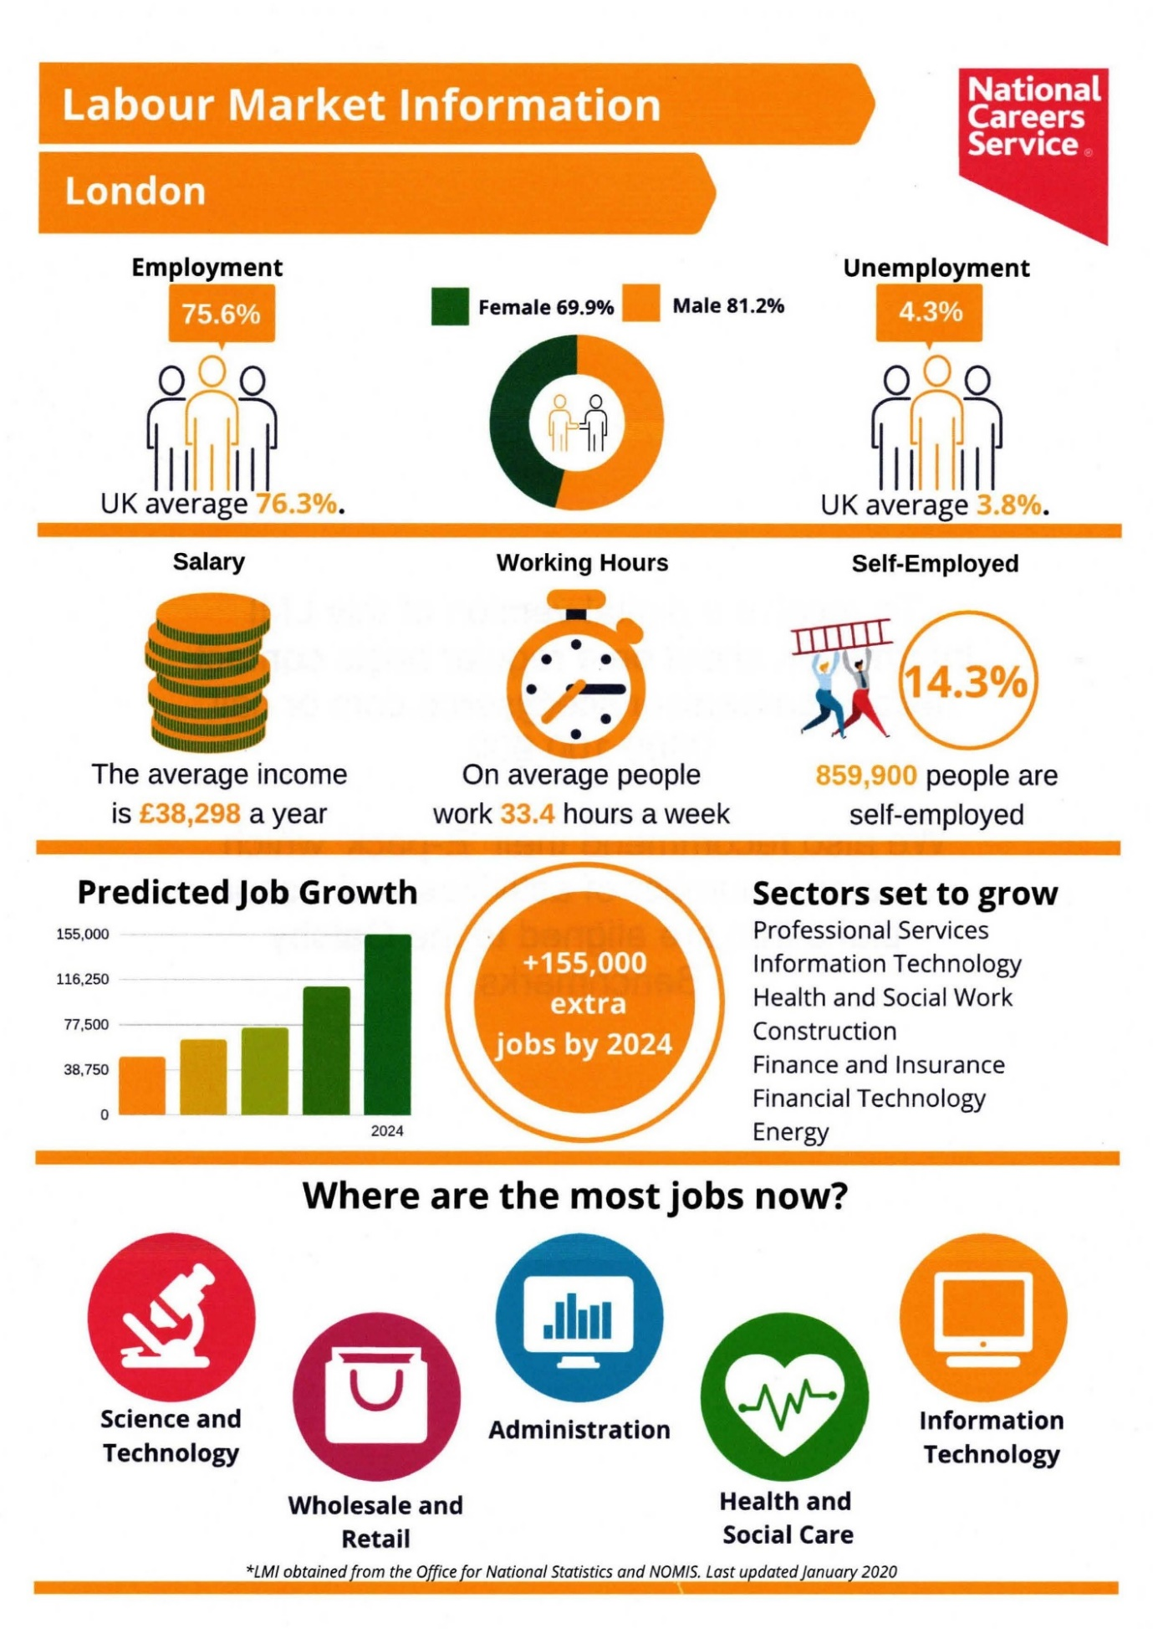


Useful Links
https://www.lmiforall.org.uk/
http://skillsmatch.intelligentlondon.org.uk/schools_colleges

